Slide 1
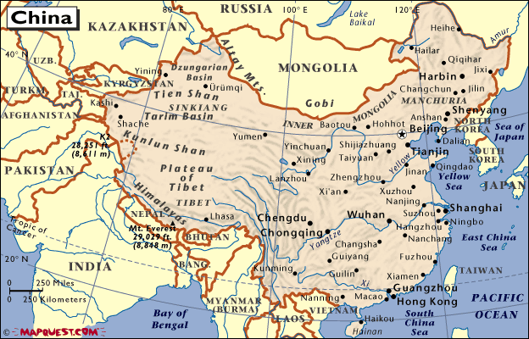
Where is China?
China is in Asia
China borders 14 other countries
4 seas border china too
Click here to listen to the national anthem

Slide 2
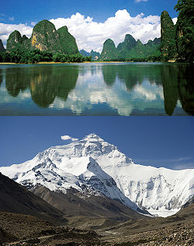
The Geography of China
China has an area 9,596,960 Sq. Kms
Shanghai and Beijing are two of the largest and most populous cities in the world
Everest is in China

Slide 3
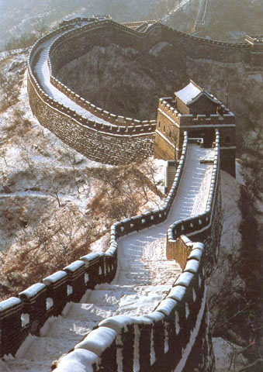
Fun Facts About China
Did you know that:
  1/5th of the worlds population lives in China
  The great wall of China is 1,500 miles long and can be seen from space

Slide 4
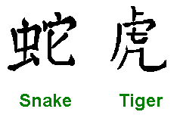
More Fun Facts
Did you also know:
  Ice cream was invented in China about 4000 years ago
  In China, each month is represented by a different animal

